Slide 1

Group Name : Error 404 :Not Found Project Name : Notes Found
Kuldeep Bamrah( C0757769 )
Rizul goyal( C0766598 )
Anmol Sharma( C0761755 )
Submitted To : Mohammad Kiani

Slide 2
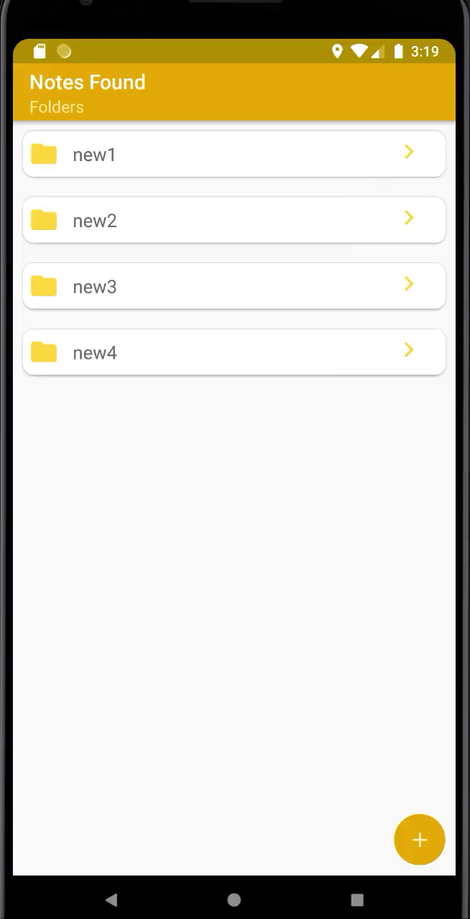
Overview of the application
We have created an application that allows the user to take notes and organise these notes by their category with some additional features.

Slide 3
Features Of Notes App
Adding Folder
Sorting Notes
Adding Images
Adding Sound
Storing Location
Navigating to the location
Swipe to Delete
Swipe to Change Folder

Slide 4
Purpose :
The Purpose of this app to make the notes taking process as simple as possible with all the functionality that the user may wants like Adding images, sound, saving the location where notes taken , navigating to the location where notes are taken and many more like swipe to delete , swipe to change the directory , sorting and searching.

Slide 5
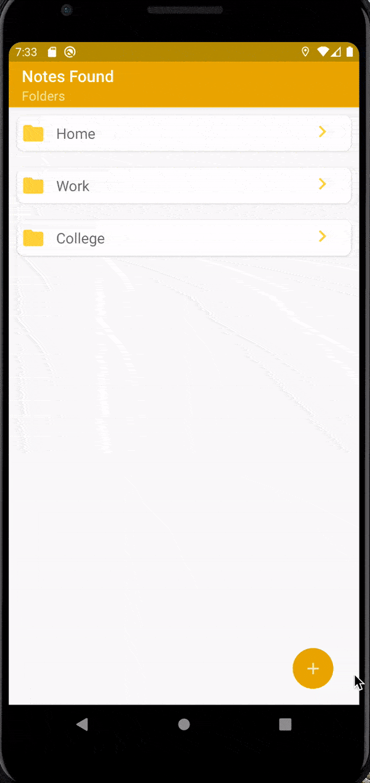
Adding Folders
Add Notes : In this a user can add folder. This will help the user to categorize the notes. To add a note click on the Floating action button at the button and this will pop up a Dialog box which will prompt you to enter the folder name and after writing click on add category.

Slide 6
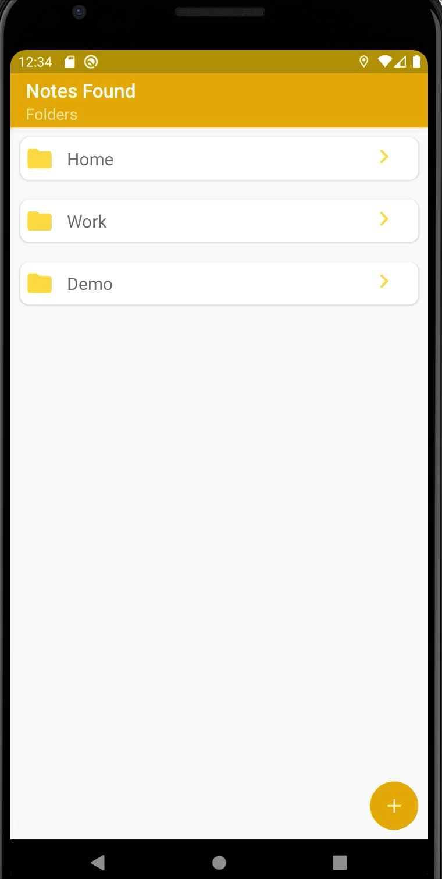
Adding Notes
Add Notes : In this on selecting a category you will be taken to a new activity screen which will show you Floating button(+) which will take you to new activity and here you can add a Title, Description, image, audio.

Slide 7
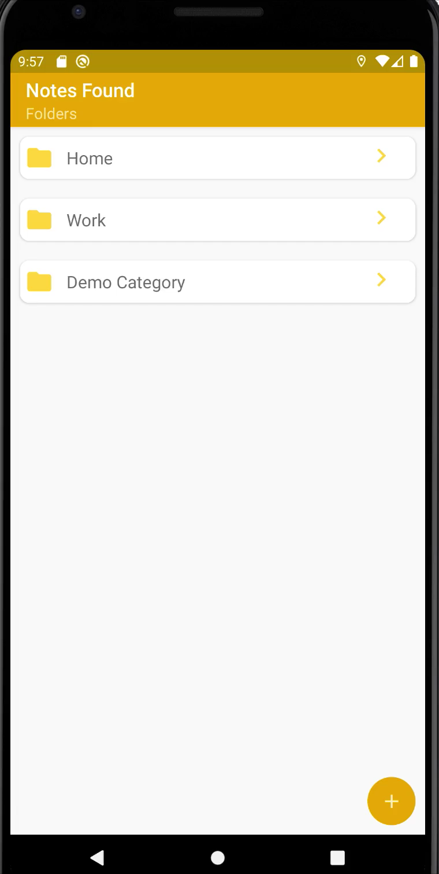
Location & Date
Location : In this whenever User press the save button the current coordinates and current date with time gets saved with notes in database and user can also navigate to the place where note is taken.

Slide 8
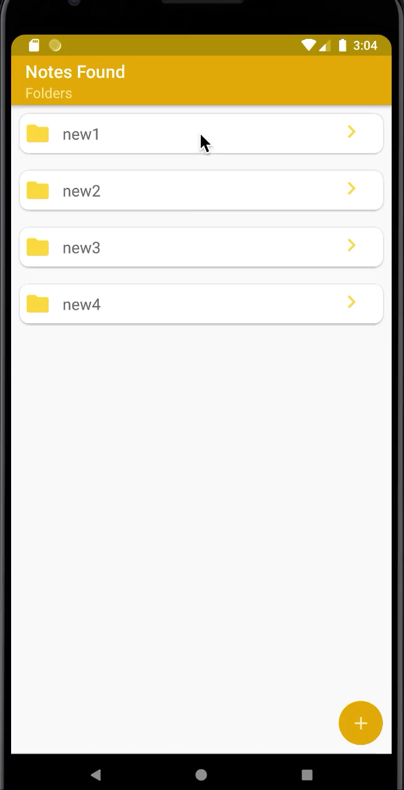
Adding Picture
Add Picture : This Feature is added for the user to add picture in their notes app to add a picture just click on the camera icon and this will give you few options like choose from gallery or click a picture choose your desired option and after selecting or clicking the image will be added to the notes.

Slide 9
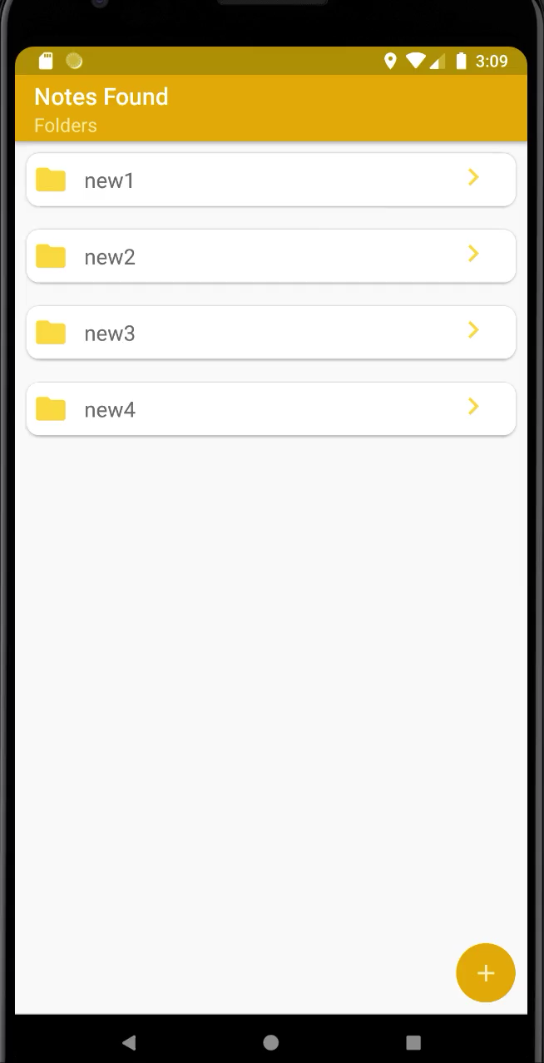
Adding Audio
Add Audio : To add audio click on the microphone icon on the bottom this will create the instance of mediaplayer class and then setting the audiopath.

Slide 10
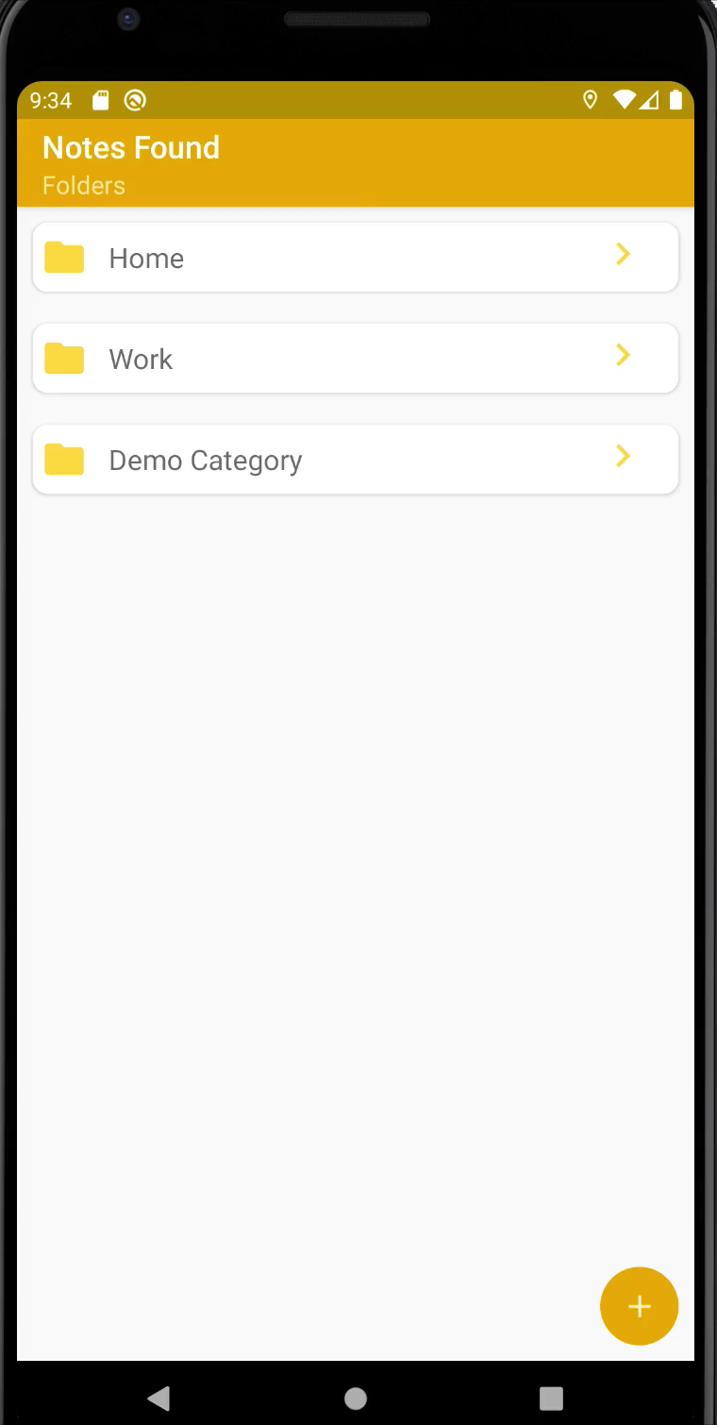
Deleting Notes
Deleting Notes: To delete a note there are two methods :
Delete through Button
Swipe to delete
Delete through Button : In this when ever user press the delete button method it will delete the current opened note from the database.

Slide 11

Deleting Notes using swipe Gesture
Delete through Swipe : In this whenever user swipe on the particular cardview it will get deleted the from the database.

Slide 12
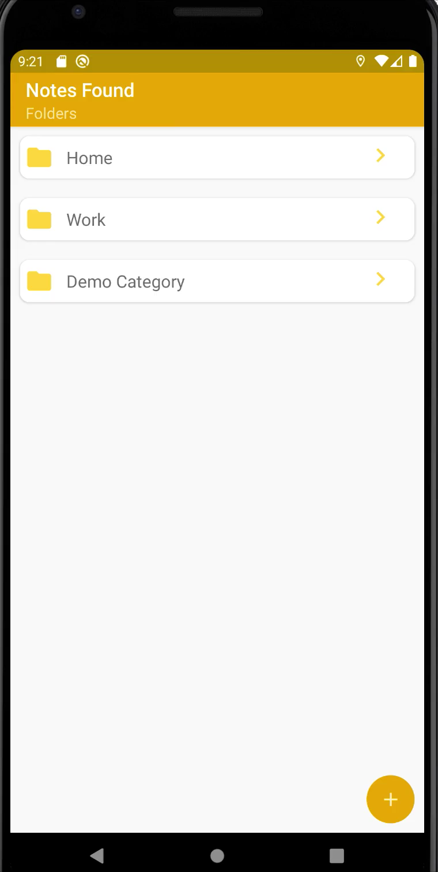
Changing Notes Folder
Changing Notes Folder: In this we are changing the category folder of the notes to change the category user have to press and hold the note and it will popup a dialog box containing all the category folder and user can select the folder of his choice.

Slide 13
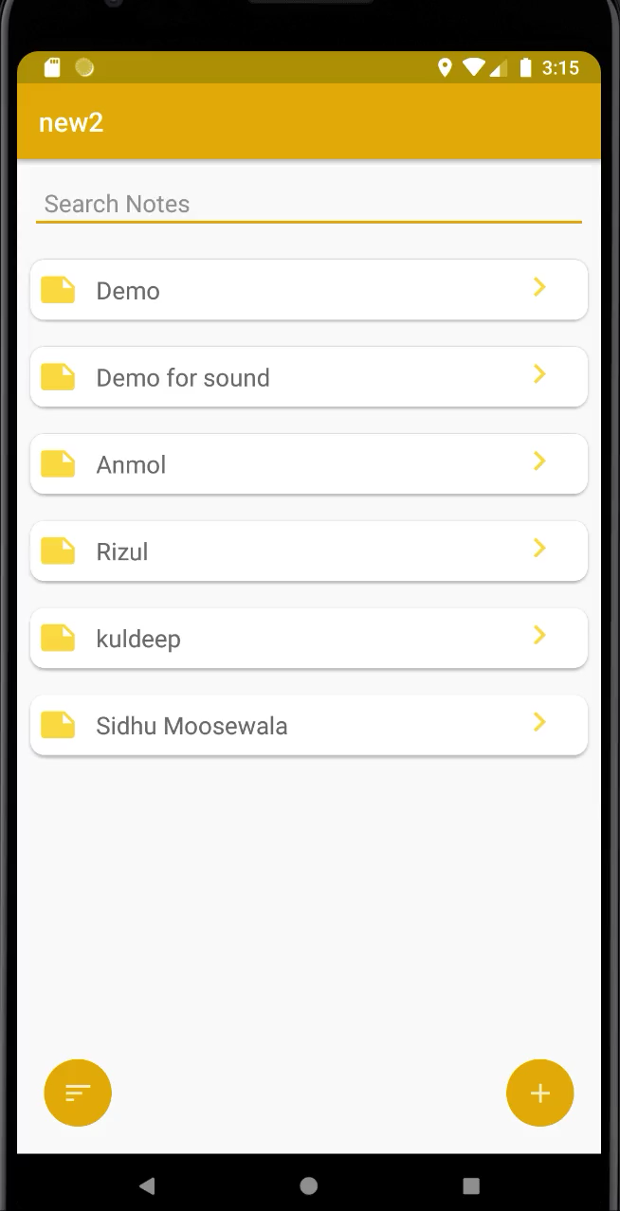
Sorting
Sorting : On clicking sort By Button a dialog will be popped up asking the user to select from two options that is :
Sort By Title
Sort By Date
and it will call the following function and will change the sort order by the selected option.

Slide 14

Searching
Searching : This feature will come in handy when the user have a lot of notes and at that time user can click on the search bar and can type the name of the note and search will show the results as per keywords entered.

Slide 15

Editing Notes
Editing : As the name describes you can also edit notes and add image, audio and do can also remove the existing ones and can save them.
Here is an example of adding image to existing note.

Slide 16
Difficulties Faced
Associating images with notes.
Associating sound with the notes.
Editing Notes With image and audio file.
Changing folder for notes.

Slide 17
Resources Used :
https://medium.com/
http://www.stackoverflow.com/
https://developer.android.com/docs
https://www.tutorialspoint.com/android/index.htm

